Slide 1
Software Product Line Analysis Techniques
Ramy Shahin
Qualifying Oral - March 19th 2018

Slide 2
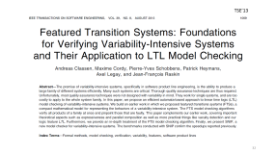
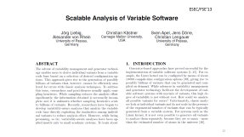
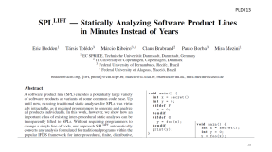
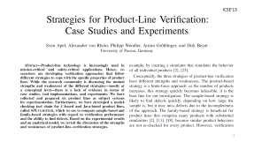
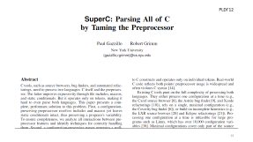
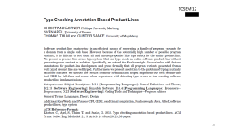
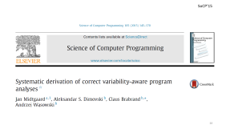

Slide 3
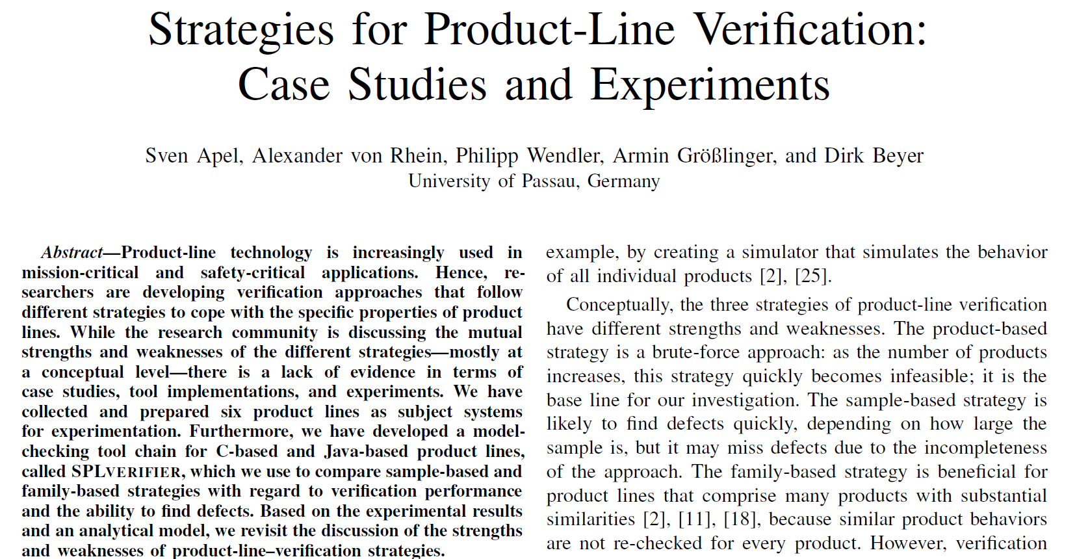
ICSE’13

Slide 4
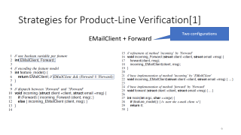
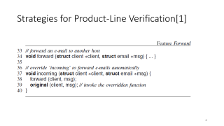
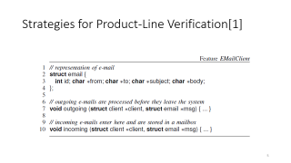
Strategies for Product-Line Verification[1]
Generative SPL

Slide 5
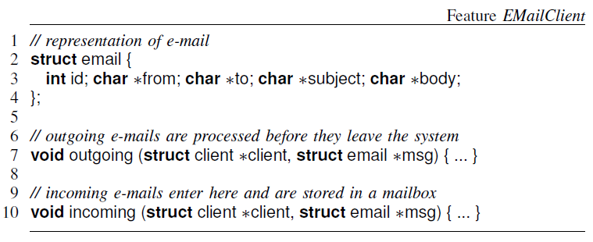
Strategies for Product-Line Verification[1]

Slide 6
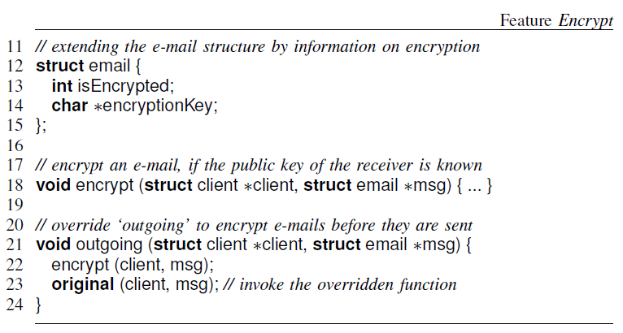
Strategies for Product-Line Verification[1]
Notes:
ICSE’13 – Sven Apel et al. – University of Passau, Germany
Product-based, Sample-based and Family-based strategies

Slide 7
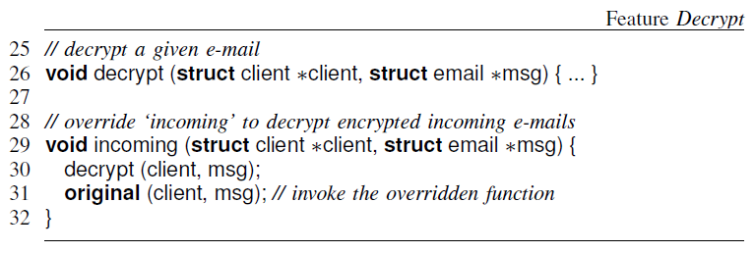
Strategies for Product-Line Verification[1]
Notes:
ICSE’13 – Sven Apel et al. – University of Passau, Germany
Product-based, Sample-based and Family-based strategies

Slide 8
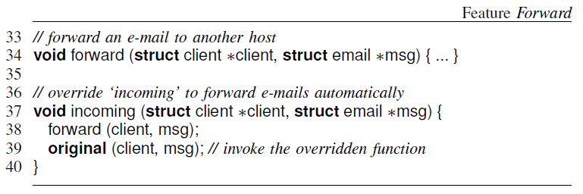
Strategies for Product-Line Verification[1]
Notes:
ICSE’13 – Sven Apel et al. – University of Passau, Germany
Product-based, Sample-based and Family-based strategies

Slide 9
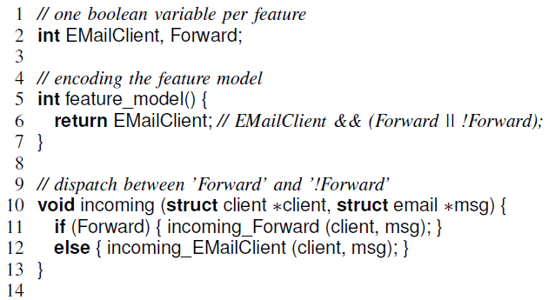
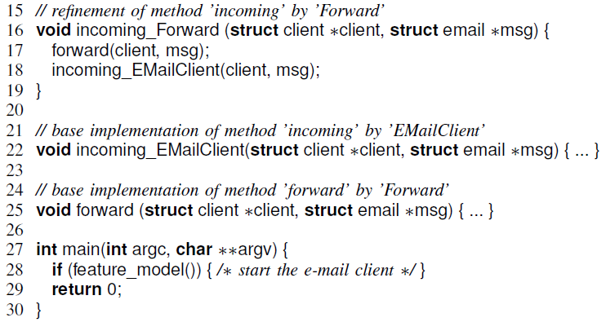
Strategies for Product-Line Verification[1]
Two configurations
EMailClient + Forward
Notes:
Aspect weaving
Boolean variable per feature
Feature model predicate
Incoming dispatch function

Slide 10
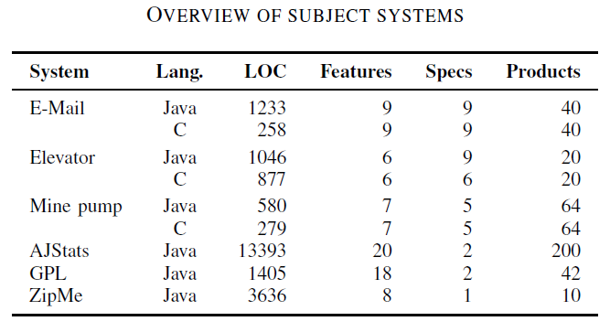
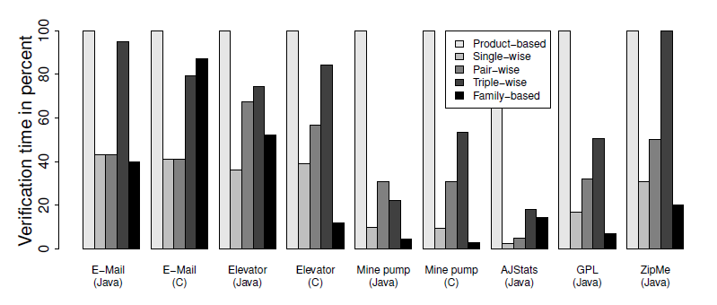
Strategies for Product-Line Verification[1]
Notes:
Evaluation: small systems (LOC, features, specifications and # of products)
CPAChecker for C code, Java Pathfinder for Java
Product-based is the baseline
Sampling does not find all defects
In some cases family-based outperform sampling

Slide 11
Strategies for Product-Line Verification[1]
Compares product-based, sampling-based and family-based strategies
Uses existing model checkers (CPAChecker and Java Pathfinder) as is
Applicable only to generative product lines
Only supports very basic forms of variability
Generates a new function per configuration
Evaluates only single-wise, pair-wise and triple-wise sampling
Notes:
Evaluation: small systems (LOC, features, specifications and # of products)
CPAChecker for C code, Java Pathfinder for Java
Product-based is the baseline
Sampling does not find all defects
In some cases family-based outperform sampling

Slide 12
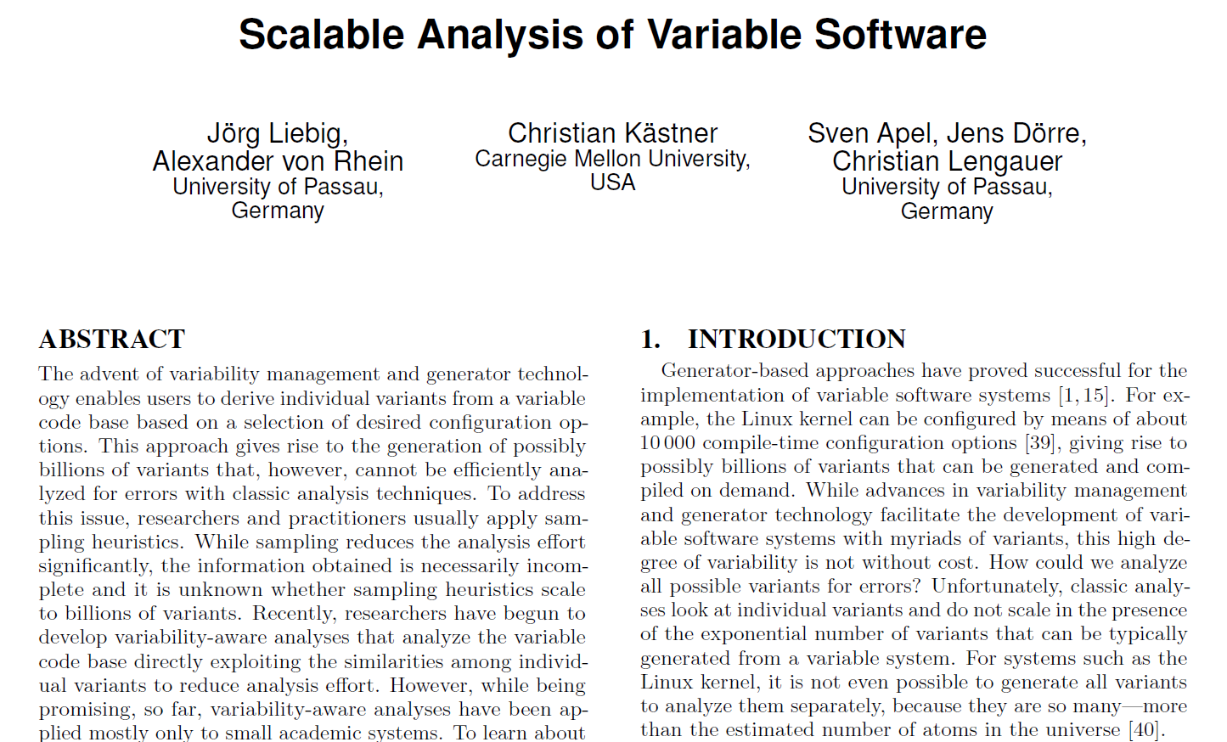
ESEC/FSE’13

Slide 13
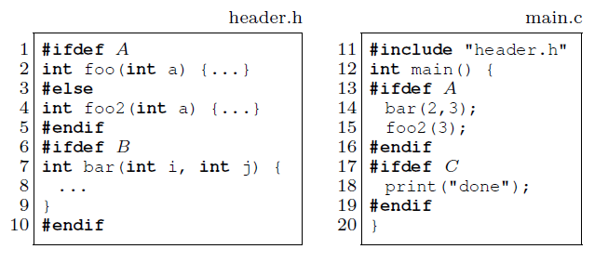
Scalable Analysis of Variable Software
Sampling Strategies:
Single-conf (e.g. {B,C})
Random
Code-coverage (e.g. {}, {A,B,C})
Pair-wise ({}, {A,B}, {B,C}, {A,C})
Annotative SPL (3 optional features)

Slide 14
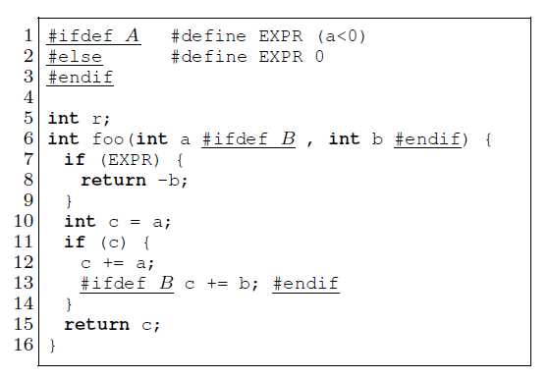
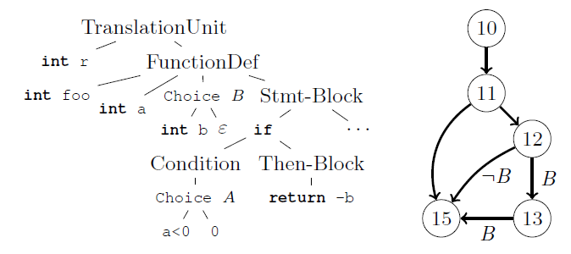
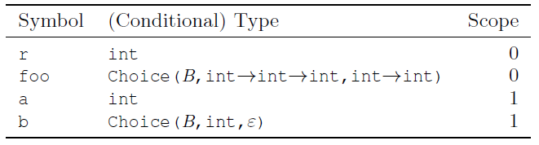
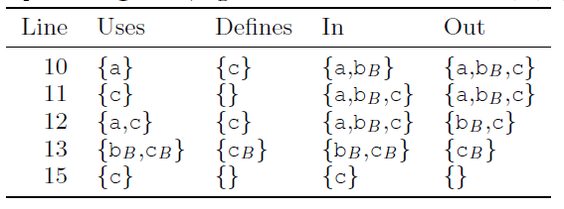
Scalable Analysis of Variable Software

Slide 15
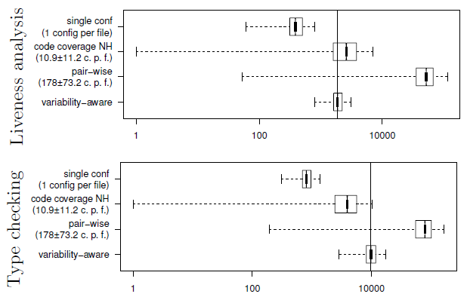
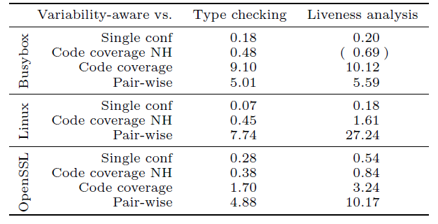
Scalable Analysis of Variable Software

Slide 16
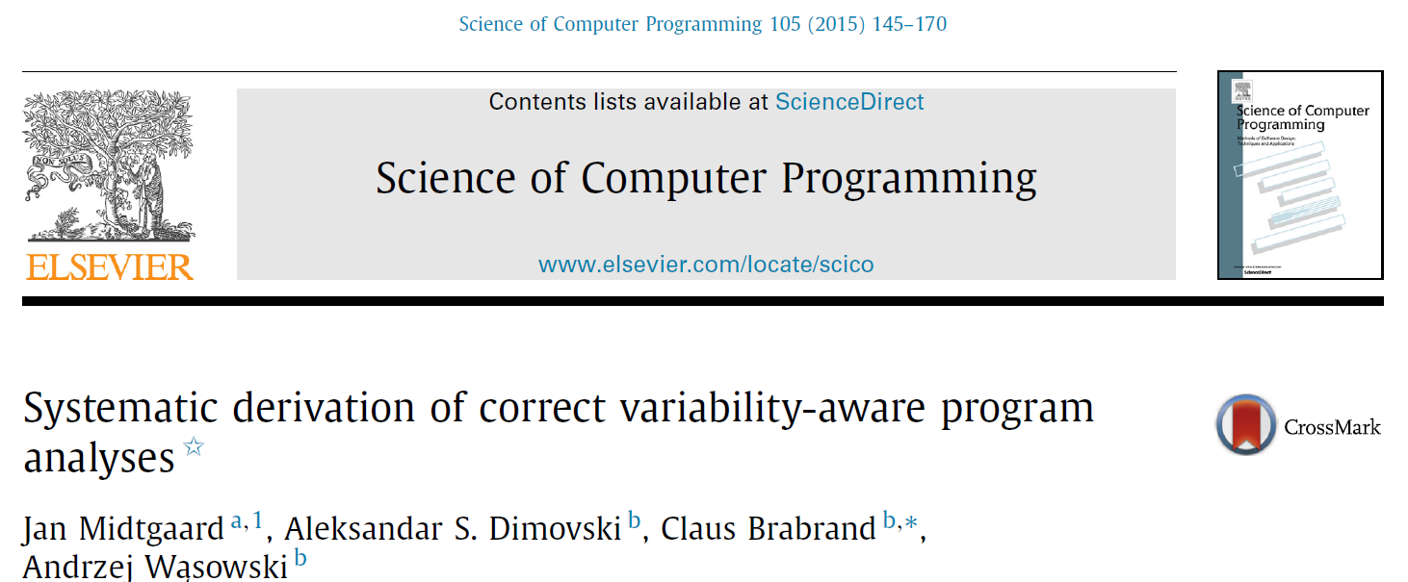
SoCP’15

Slide 17
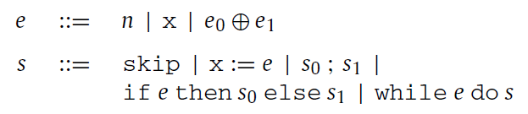
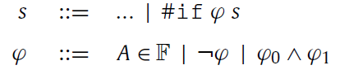
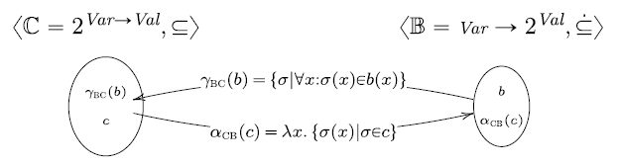
Variability-Aware Abstract Interpretation
Imperative language (annotative)
Semantics in terms of (Variable, Value) stores

Slide 18
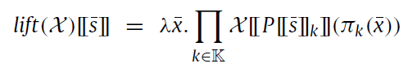
Variability-Aware Abstract Interpretation
Lifting combinator (a tuple of values, one per configuration):
Optimization: value sharing (shorter tuples)
Lossy optimization: variability abstraction
Compositionality of Galois connections
Minimum abstraction: fully preserves variability
Maximum abstraction: map all configurations into one

Slide 19
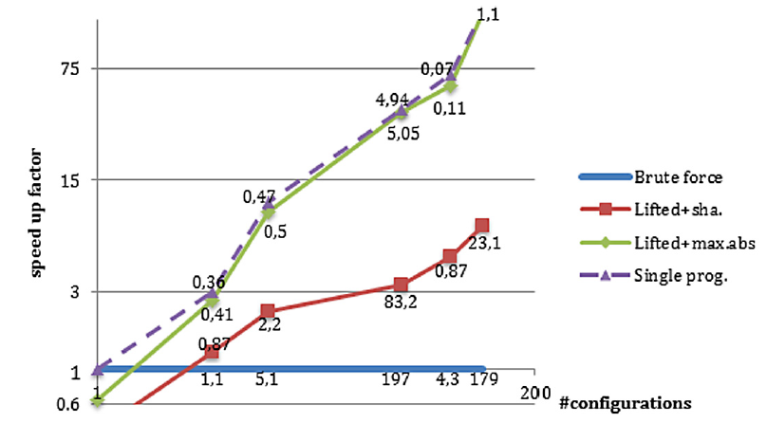
Variability-Aware Abstract Interpretation

Slide 20
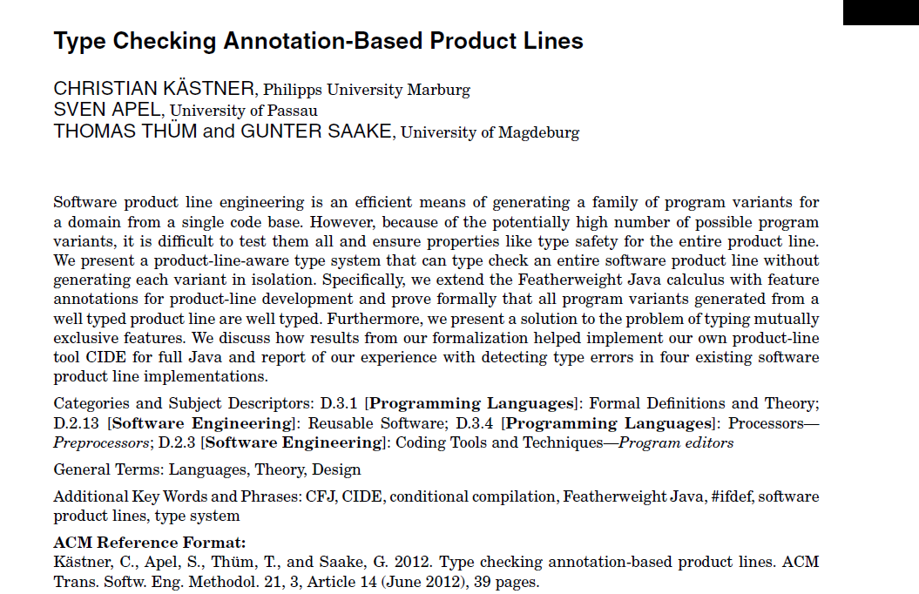
TOSEM’12

Slide 21
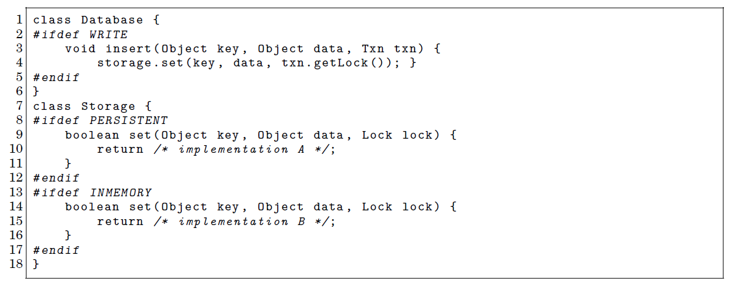
Product Line Type Checking

Slide 22
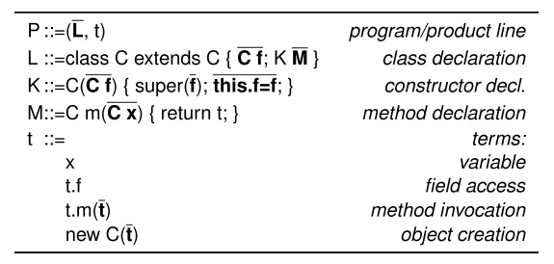
Product Line Type Checking
Colored Featherweight Java (CFJ) (annotative – limited)
Goals:
Product generation preserves typing
Backward compatibility (extends the Java Type System)
Type Checking: reachability rules (target reachable from reference)

Slide 23
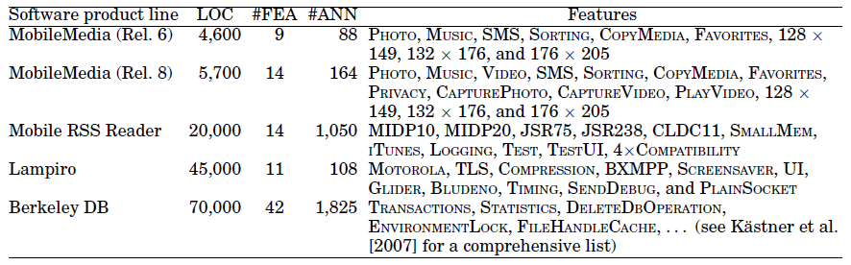
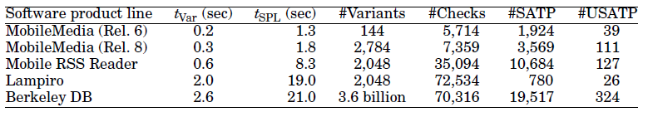
Product Line Type Checking

Slide 24
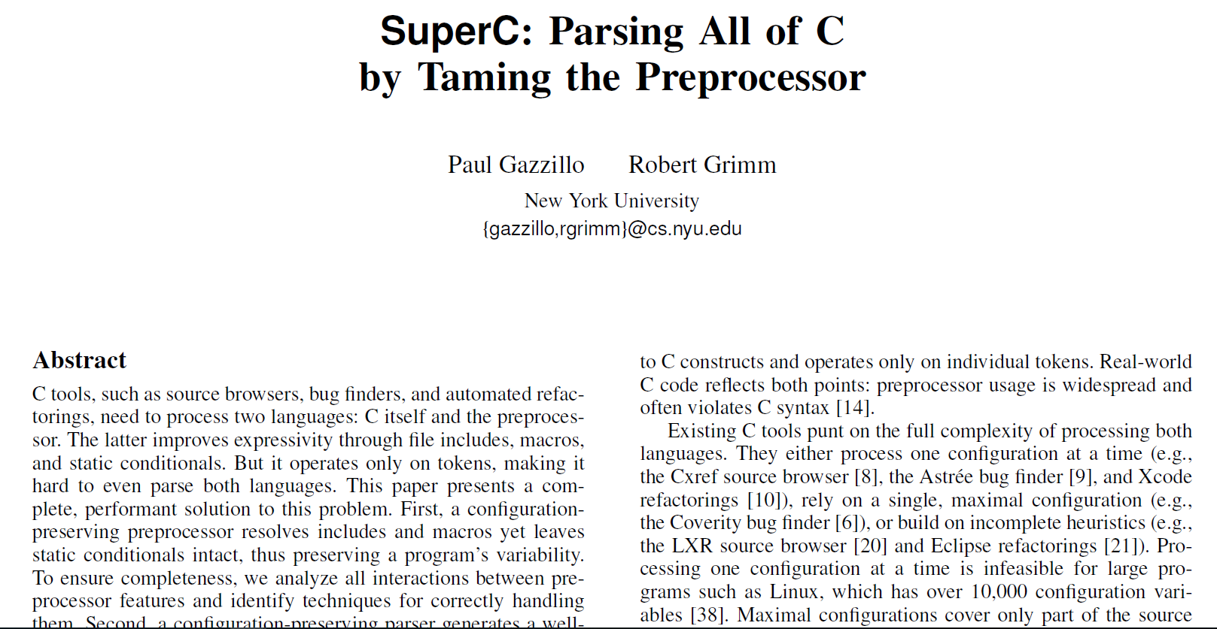
PLDI’12

Slide 25
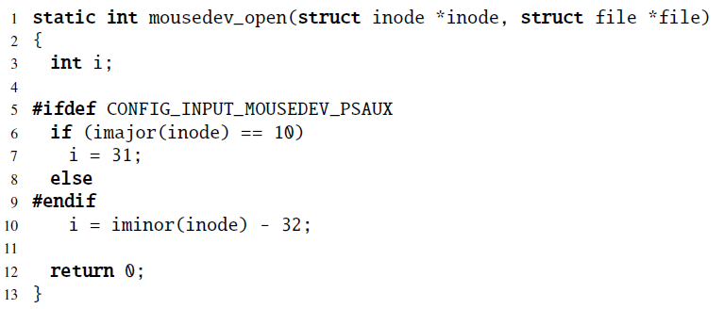
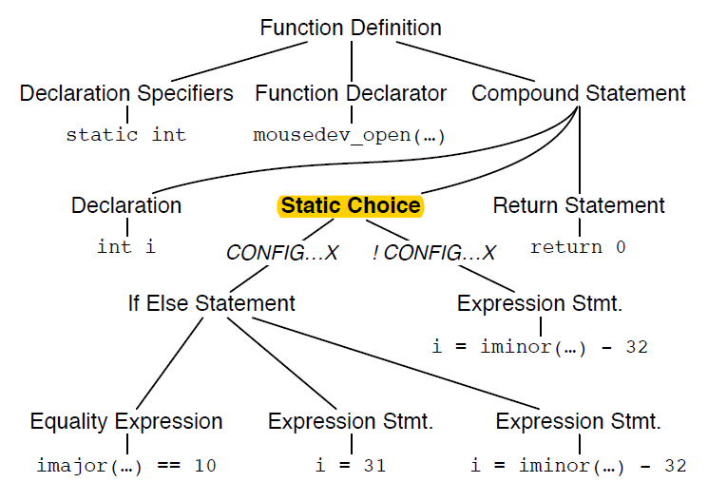
SuperC

Slide 26
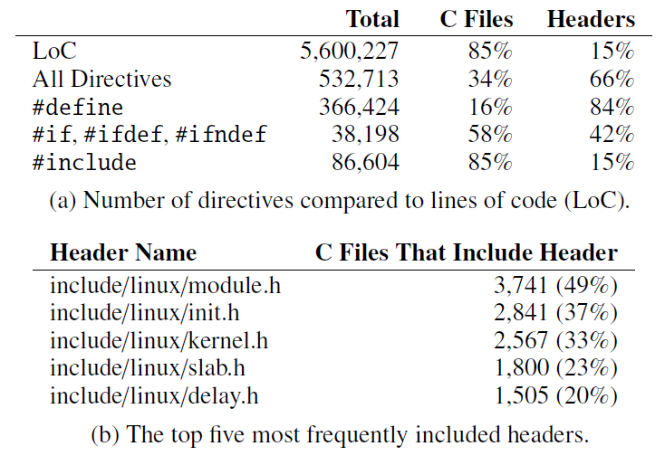
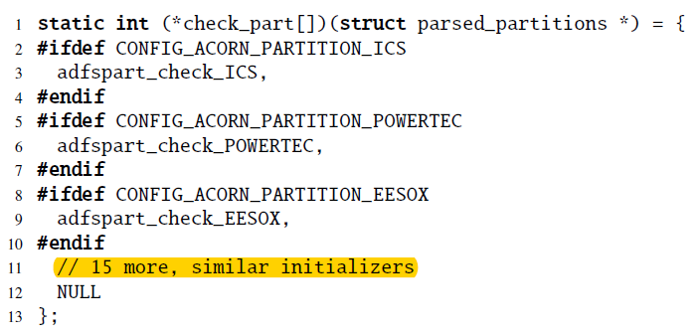
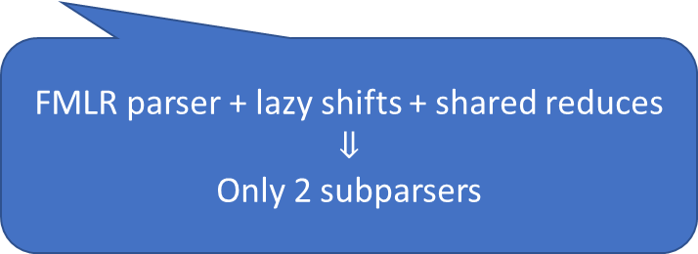
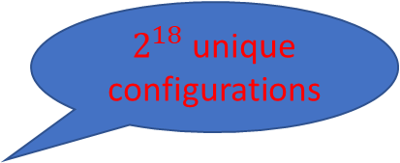
SuperC
block/partitions/check.c:
$2^{18}$ unique configurations
FMLR parser + lazy shifts + shared reduces
$$⇓$$
Only 2 subparsers

Slide 27
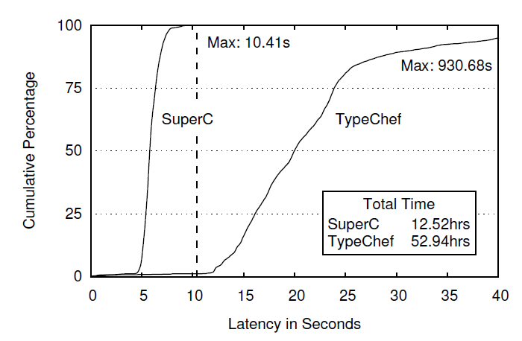
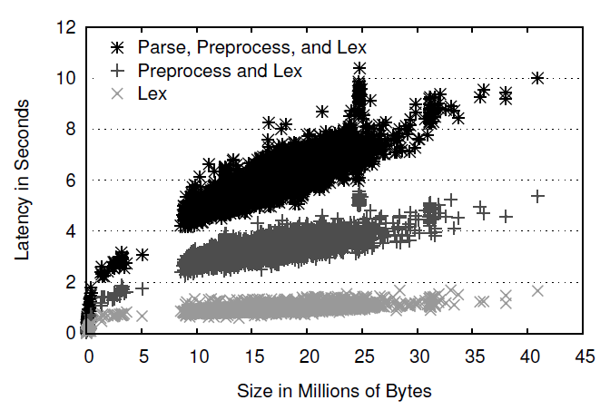
SuperC

Slide 28
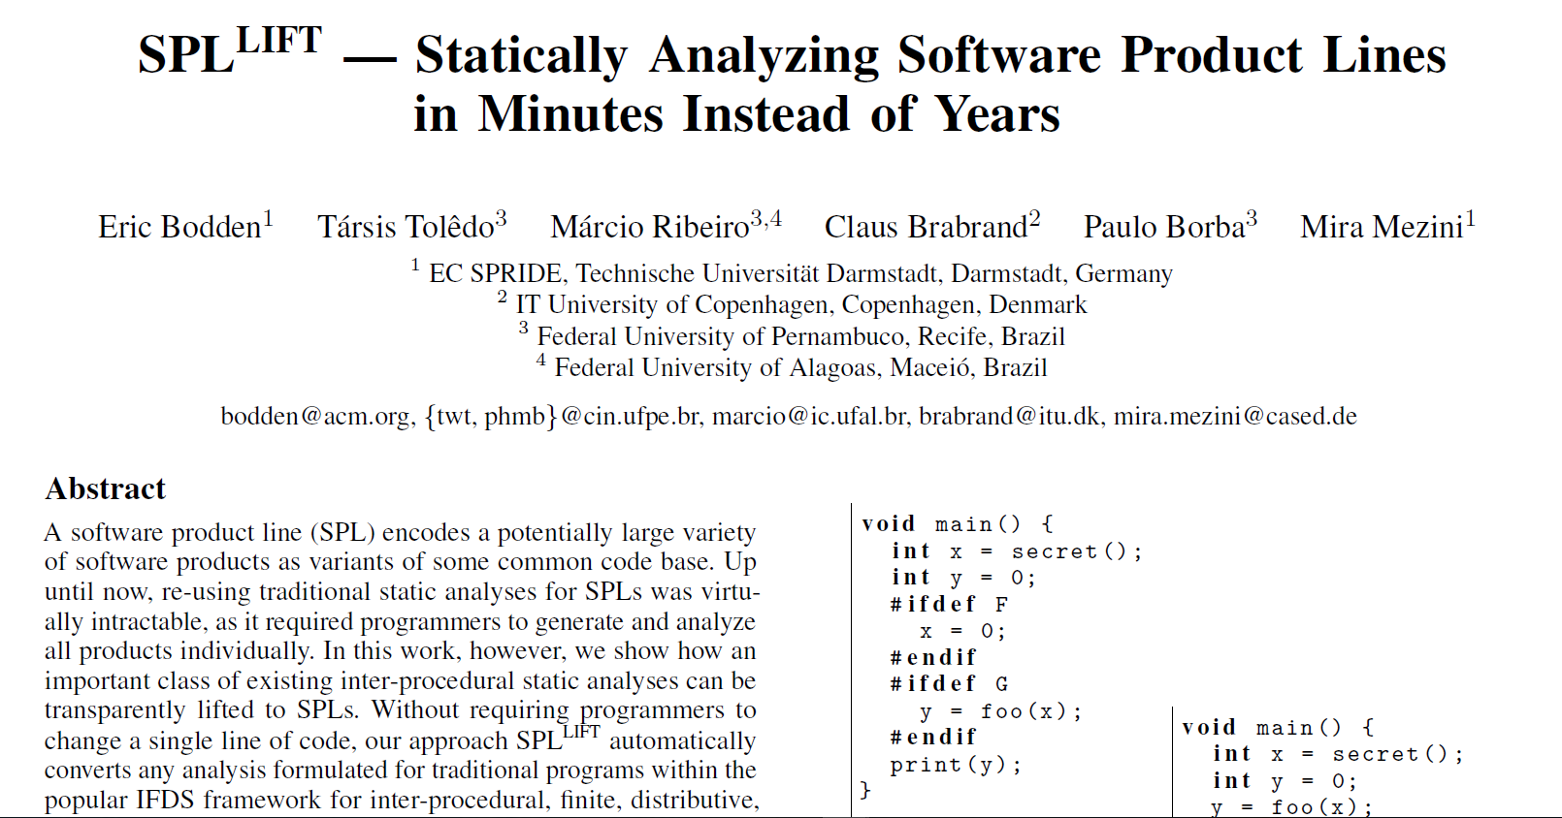
PLDI’13

Slide 29
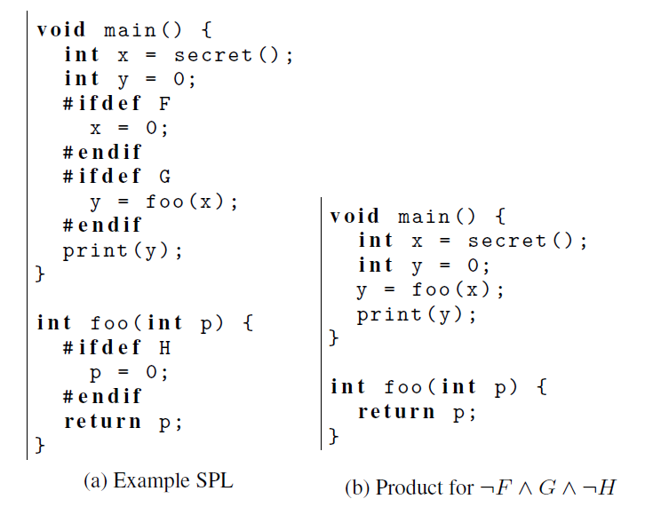
SPL^{LIFT}
Secret is leaked!!

Slide 30
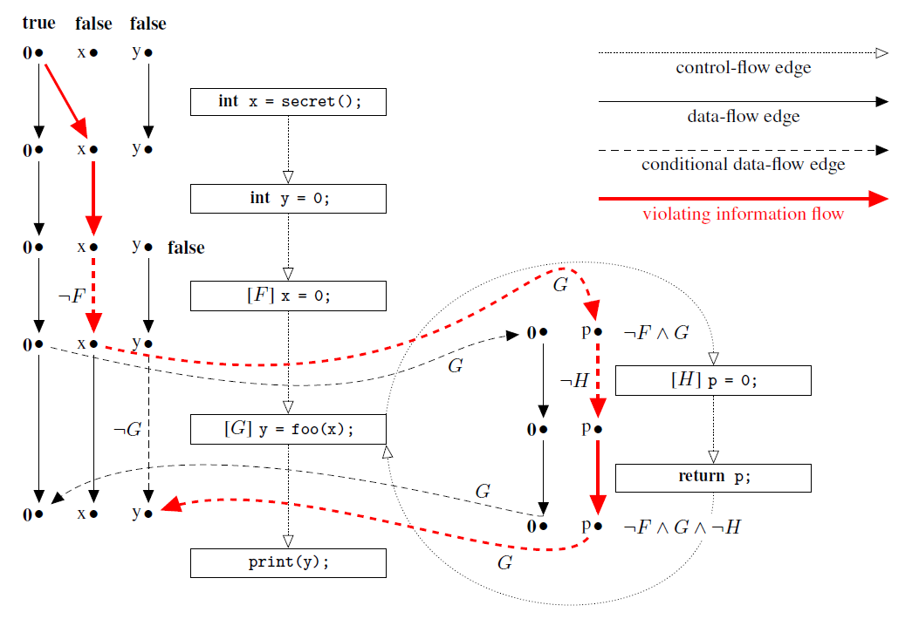

SPL^{LIFT}

Slide 31


SPL^{LIFT}

Slide 32

TSE’13

Slide 33



Featured Transition Systems

Slide 34

Featured Transition Systems
Feature LTL (fLTL) – LTL expressions enriched with feature expressions
fPromela
SNIP model checker

Slide 35


Featured Transition Systems

Slide 36
References
[1] S. Apel, A. v. Rhein, P. Wendler, A. Gröÿlinger, and D. Beyer. Strategies for Product-Line Verification: Case Studies and Experiments. In Proceedings of the 2013 International Conference on Software Engineering, ICSE '13, pages 482491, Piscataway, NJ, USA, 2013. IEEE Press.
[2] J. Liebig, A. von Rhein, C. Kästner, S. Apel, J. Dörre, and C. Lengauer. Scalable Analysis of Variable Software. In Proceedings of the 2013 9th Joint Meeting on Foundations of Software Engineering, ESEC/FSE 2013, pages 8191, New York, NY, USA, 2013. ACM.
[3] J. Midtgaard, A. S. Dimovski, C. Brabrand, and A. W¡sowski. Systematic derivation of correct variability-aware program analyses. Sci. Comput. Program., 105(C):145170, July 2015.
[4] C. Kästner, S. Apel, T. Thüm, and G. Saake. Type Checking Annotation-Based Product Lines. ACM Trans. Softw. Eng. Methodol., 21(3):14:114:39, July 2012.
[5] P. Gazzillo and R. Grimm. SuperC: Parsing All of C by Taming the Preprocessor. In Proceedings of the 33rd ACM SIGPLAN Conference on Programming Language Design and Implementation, PLDI '12, pages 323334, New York, NY, USA, 2012. ACM.
[6] E. Bodden, T. Tolêdo, M. Ribeiro, C. Brabrand, P. Borba, and M. Mezini. SPLLIFT: Statically Analyzing Software Product Lines in Minutes Instead of Years. In Proceedings of the 34th ACM SIGPLAN Conference on Programming Language Design and Implementation, PLDI '13, pages 355364, New York, NY, USA, 2013. ACM.
[7] A. Classen, M. Cordy, P.-Y. Schobbens, P. Heymans, A. Legay, and J.-F. Raskin. Featured Transition Systems: Foundations for Verifying Variability-Intensive Systems and Their Application to LTL Model Checking. IEEE Trans. Softw. Eng., 39(8):1069-1089, Aug. 2013.

